Slide 1
RMU Intern Tracking System
Charles Gross
Robert Morris University
Dr. Karen Paullet
INFS 3220 Systems Analysis & Design
Section C1: Online
April 19, 2014

Slide 2
SYSTEMS PLANNING
Conduct a preliminary investigation in “order to study the systems request and recommend specific action” (Shelly & Rosenblatt, 2012, p. 71).
Review the information that has already been provided in the systems request.
Analyze the information provided about the existing system to “determine which departments, users, and...processes are involved” (Shelly & Rosenblatt, 2012, p. 73).
Perform additional fact finding in the form of interviews with students, advisors, career services, and internship company supervisors in order to “gather data about project usability, costs, benefits, and schedules” (Shelly & Rosenblatt, 2012, p. 77).

Slide 3
SYSTEMS PLANNING cont.
Evaluate the project’s feasibility using “four main yardsticks...operational feasibility, technical feasibility, economic feasibility, and schedule feasibility” (Shelly & Rosenblatt, 2012, p. 66).
Present all of my findings to the RMU President and representation from the faculty, career services, and the student body in the form of a Preliminary Investigation report that includes “an evaluation of the systems request, an estimate of costs and benefits, and a case for action” (Shelly & Rosenblatt, 2012, p. 66).

Slide 4
SYSTEMS ANALYSIS: Requirements Modeling
A successful analyst must first “determine the requirements before starting the design process” (Shelly & Rosenblatt, 2012, p. 139).
Create a requirements model built from the results of additional fact-finding
data from the initial interviews
observation of the manual system in action
sampling of the existing records for students that have completed internships through the manual process

Slide 5
SYSTEMS REQUIREMENTS for the Intern Tracking System
Outputs
Students, advisors, and career services must be able to see student internships that have been applied to, are in progress, and have previously been completed.
Advisors, career services, and supervisors must be able to see all submitted, approved, and past internship job postings.
Students, advisors, and career services must be able to see final evaluations.
Students must be notified of internship interview requests.

Slide 6
SYSTEMS REQUIREMENTS for the Intern Tracking System
Input
Company supervisors enter available internships at their company, approve student applications, enter intern progress, and finalize evaluations.
Career services approves internships submitted by companies and answers help requests.
Students apply to internships, enter their progress, and finalize evaluations.
Faculty advisors approve internships, student applications, and view/comment on student progress.

Slide 7
SYSTEMS REQUIREMENTS for the Intern Tracking System
Process
The internship tracking system must interface properly with Sentry Secured Services.
The system must notify users via email when they are required to perform an action like approve a posting or approve a student application.
The system must again notify users, when after 72 hours, they have not fulfilled an action required on their part.
The system must not automatically reject students applying to a position that their advisor previously declined.

Slide 8
SYSTEMS REQUIREMENTS for the Intern Tracking System
Performance
The system must support the entirety of the student body, faculty, and RMU career services.
Response time must not exceed 2 seconds.
The system must be operational seven days a week, 365 days a year.

Slide 9
SYSTEMS REQUIREMENTS for the Intern Tracking System
Control
The system must provide logon security at the website level, using Sentry Secured Services accounts.
The system must provide logon security for company supervisors by providing access that is limited to only the Intern Tracking system.
Group specific functions must be limited to their respective groups.

Slide 10
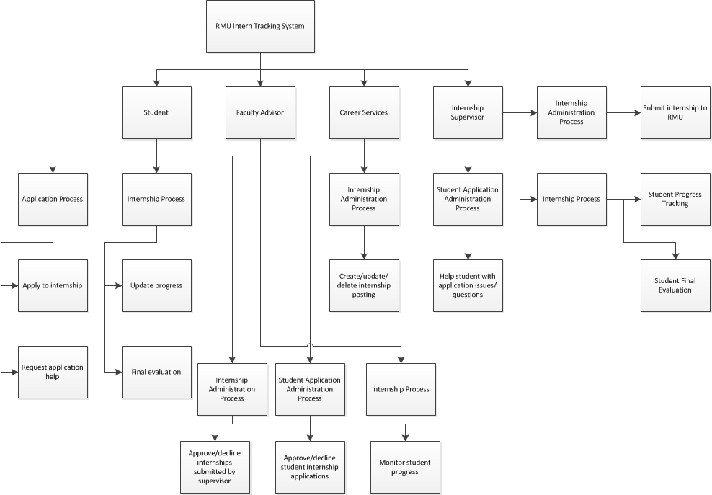
REQUIREMENTS MODELING: The Functional Decomposition Diagram

Slide 11
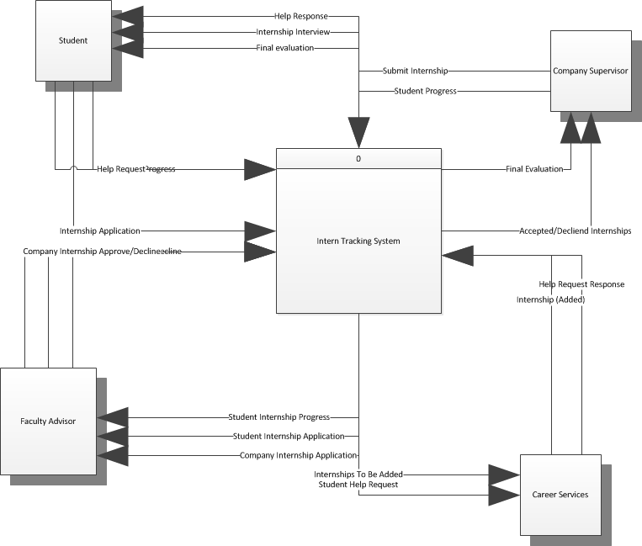
DATA AND PROCESS MODELING: The Context Diagram

Slide 12
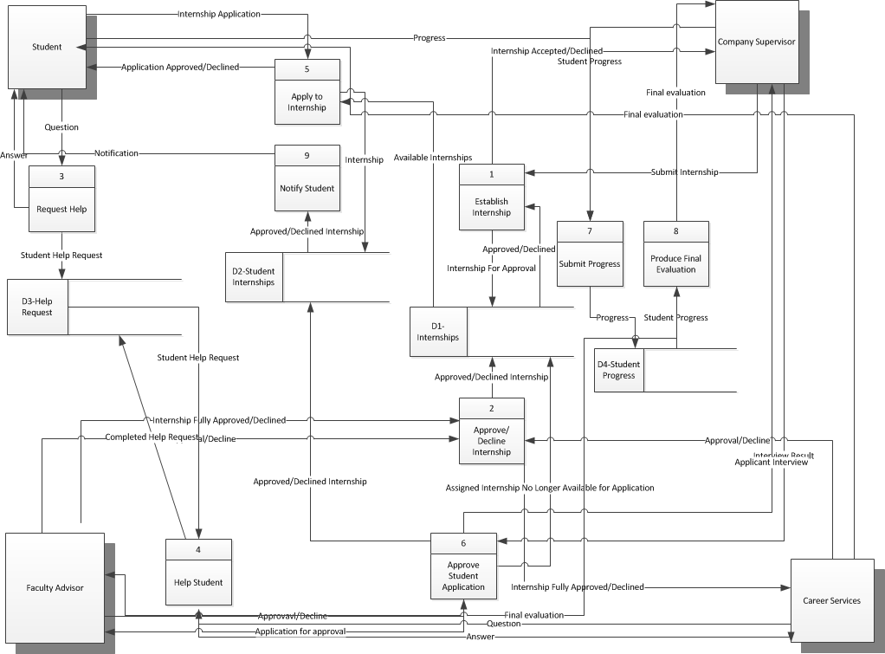
DATA AND PROCESS MODELING: Diagram 0

Slide 13
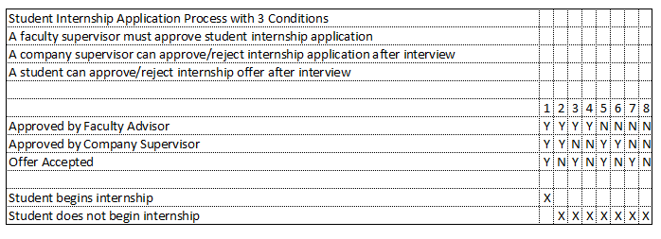
DATA AND PROCESS MODELING: Decision Table

Slide 14
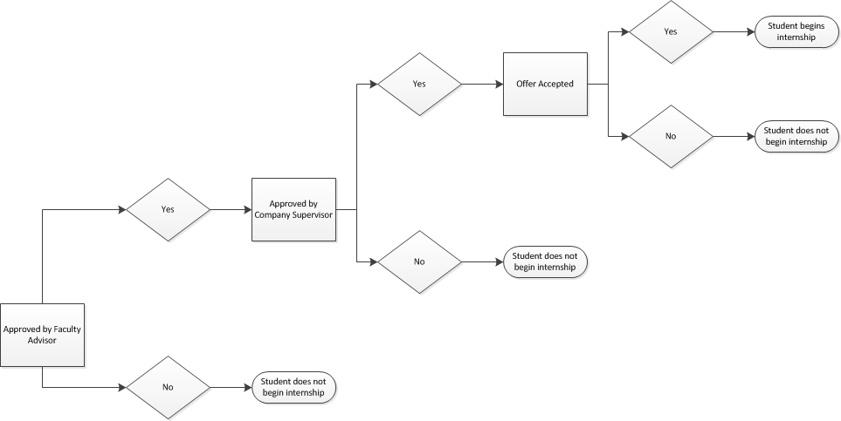
DATA AND PROCESS MODELING: Decision Tree

Slide 15
DEVELOPMENT STRATEGY RECOMMENDATION
The Intern Tracking System be entirely web based.
Multiple companies need to access the system on their own networks
Students may need to access the system off campus
Existing software would meet many of the RMU Intern Tracking system requirements, but it does not integrate with any existing login systems so it does not meet the requirement of integration with Secured Sentry.

Slide 16
DEVELOPMENT STRATEGY RECOMMENDATION
RMU should commit the initial development cost to custom building their own system
As the university continues to grow, the intern tracking system can be more easily modified to changes in how RMU handles the internship process
RMU will not rely on “an outside firm for vital business support” (Shelly & Rosenblatt, 2012, p. 295).

Slide 17
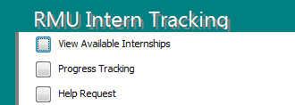
RMU INTERN TRACKING SYSTEM Website Menu for Student

Slide 18
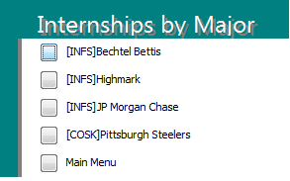
RMU INTERN TRACKING SYSTEM Website Menu for Student

Slide 19
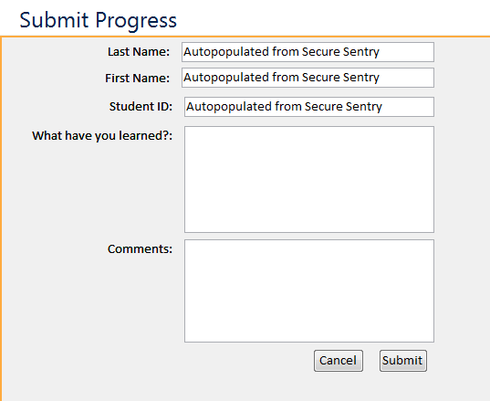
RMU INTERN TRACKING SYSTEM Website Menu for Student

Slide 20
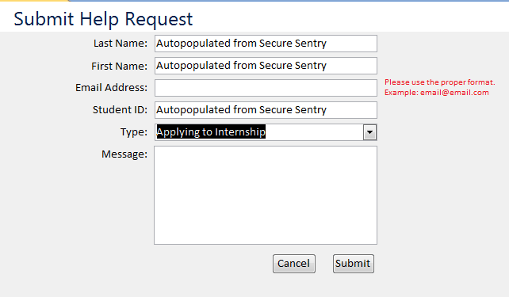
RMU INTERN TRACKING SYSTEM Website Menu for Student

Slide 21
Works Cited
Shelly, G., & Rosenblatt, H. (2012). Systems analysis and design. (9th Edition ed., p. 31). Boston MA: Course Technology Cengage Learning.

